Slide 1
Online Bus Ticket MANAGEMENT SYSTEM
Presented By
Susmoy das
Mridul sharkar
Jannatul Arefin Prima
UG02-44-17-039
Ug02-44-17-056
UG02-44-17-013
Department Of CSE
State University Of Bangladesh

Slide 2
Contents
Objectives
Project Purpose
Project Expected outcome
System Requirements

Slide 3
Objectives
Bus Ticket Booking System is an automated system for purchasing online bus tickets. Adopt your own branded website, mobile apps (Android & IOS) and allow your clients to book tickets for different routes & destinations. This system keeps the record of passengers’ details as per each bus schedule. You can also set seat availability, schedule routes, and upload interactive seat maps to assist customers pick out their preferred seats. With the help of Bus Ticket Booking System, you can reserve tickets each time anywhere with the aid of the Internet. You can also enable your clients to check the availability of buses they decide on and book the seats of their choice.
Designed by an experienced team and based on the business experience of different customers - bus operators, our bus ticketing system covers almost every possible operating process of bus operators and bus resellers. Each software part of the CW bus booking system can work individually but can also be integrated with other software parts depending on the specific needs of each client.

Slide 4
Inter City Bus Ticketing Management System
Intercity Bus ticketing software is an automated system for purchasing online bus tickets. Adopt your own branded website, mobile apps (Android & IOS) and allow your clients to book tickets for different routes & destinations. This keeps the record of passengers’ details as per each bus schedule. You can also set seat availability, schedule routes, and upload interactive seat maps to assist customers pick out their preferred seats. With the help of Bus Ticket Booking System, you can reserve tickets each time anywhere with the aid of the Internet. You can also enable your clients to check the availability of buses they decide on and book the seats of their choice.

Slide 5
Market Place Bus Ticketing Software And Bus Management System
My Application providing bus ticketing software with the facilities of multi-vendor environment. That is if you want, can manage marketplace of bus tickets. Our enable you to connect multiple operators where each operator will have their own administration and counter ticketing system as well as they will be connected with marketplace website to sell their tickets online.
Not only has this will our Android app enable your customers to buy their tickets online using online payment method. Each operator will enjoy their own bus management system including account, schedule, route, fuel, inventory, parcel system, agent management etc, all are in their dashboard.

Slide 6
Future requrment
GPS based Automatic Vehicle Tracking & Monitoring.
Logical Components of VTMS

Slide 7
MOTIVATION
Our Bus Ticket Booking System is a software designed to automate the bus ticket booking process. Run your business smoothly with the automated system by organizing the booking process easily and smartly. Get an efficient website from where your customers can book their tickets and get instant updates. From your dashboard, you can supervise bus schedule, route information, real-time location, manage seats, employees payments, customers payments, send instructions to the stuff, state updates, and so on. The Online Bus Ticketing System helps the travelers book tickets from anywhere with mobile apps, or from the website and choose their preferred available seats easily.

Slide 8
Project Purpose
The bus ticket booking takes a few convenient steps - choose trip date, start/destination point, add personal details.
They can overview all on hold seats at a look and choose seats easily.
Customers are requested to select the desired payment approach (if payments are enabled).
As quickly as the booking is completed, customers obtain a digital ticket they can print at home.

Slide 9
Project Expected outcome
Making a full furnish web application.
Well written clean code for developing.
Understanding pattern of relational database and relationship.
Easy installation software system.
Well managed front-site manager.

Slide 10
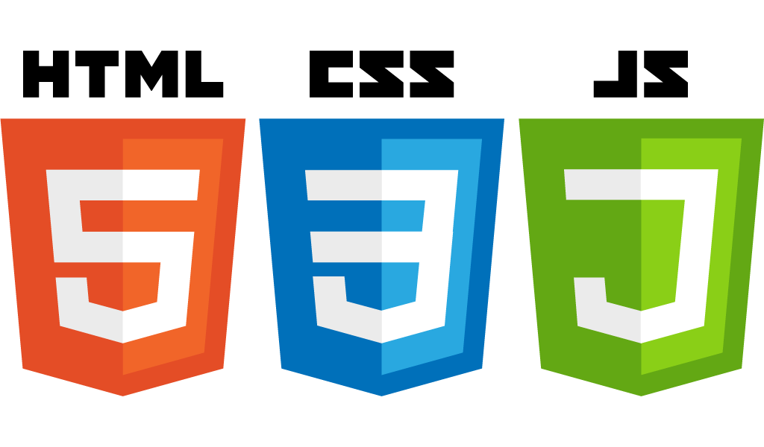


System Requirements

Slide 11
THANK YOU

